Slide 1
Creating soundscapes with littleBits
Andreas Mertin, Information Services Librarian
lib.uts.edu.au
UTS CRICOS PROVIDER CODE: 00099F

Slide 2
Today’s session
A (very) basic introduction to music with littleBits
Creating a soundscape with littleBits Synth Kit and Audacity
lib.uts.edu.au
UTS CRICOS PROVIDER CODE: 00099F

Slide 3
A (very) brief introduction to music
lib.uts.edu.au
UTS CRICOS PROVIDER CODE: 00099F

Slide 4



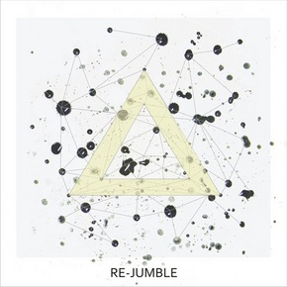

Music is built in layers
Music is built up in layers
Green Like July Crippled Inside
Wols Moonstomp_Utopia
Weldroid Copy On Fail

Slide 5
A (very) brief introduction to music
Music is about layers, but these layers interact with each other in different ways at different times. Some interactions are horizontal or linear others are vertical or textural.
lib.uts.edu.au
UTS CRICOS PROVIDER CODE: 00099F

Slide 6
Music is multidimensional
Insert topic across 1 line here
Melody
Texture
Movement
Horizontal
Temporal
Linear
Sequential
littleBits Synth Kit
Immediate
Vertical
Compound
Planar
Harmonic
Audacity

Slide 7
Setting Up
lib.uts.edu.au
UTS CRICOS PROVIDER CODE: 00099F

Slide 8
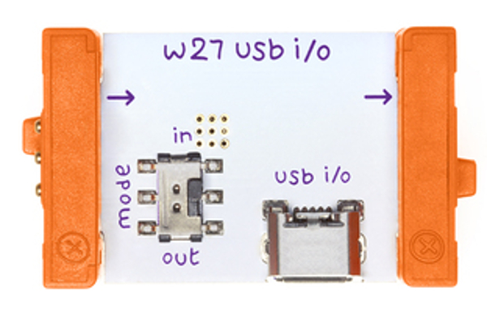
Connecting littleBits to Audacity
Setting up—Connecting littleBits to Audacity
Step 1
Connecting littleBits using USB I/O to your Mac or PC
lib.uts.edu.au
UTS CRICOS PROVIDER CODE: 00099F

Slide 9
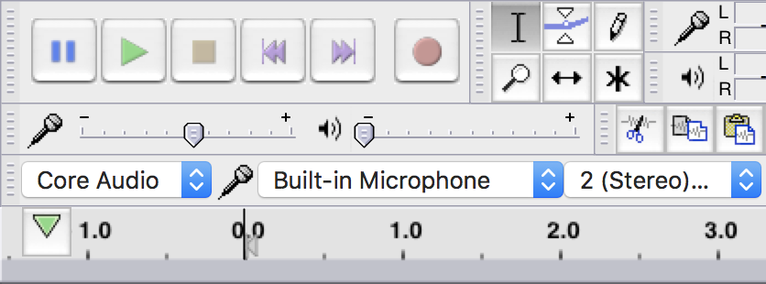
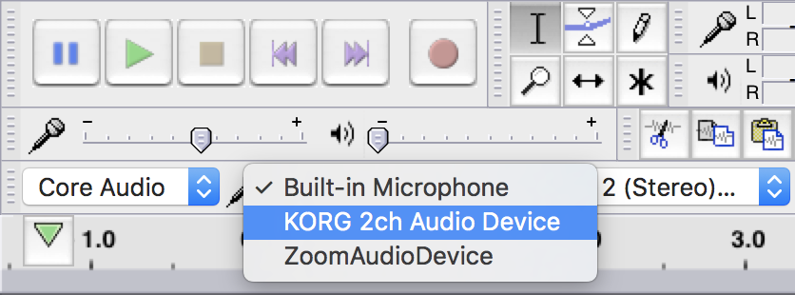
Connecting littleBits to Audacity
Setting up—Connecting littleBits to Audacity
Step 2
Open Audacity
Change the input to KORG 2ch Audio Device
lib.uts.edu.au
UTS CRICOS PROVIDER CODE: 00099F

Slide 10
Creating your soundscape
lib.uts.edu.au
UTS CRICOS PROVIDER CODE: 00099F

Slide 11
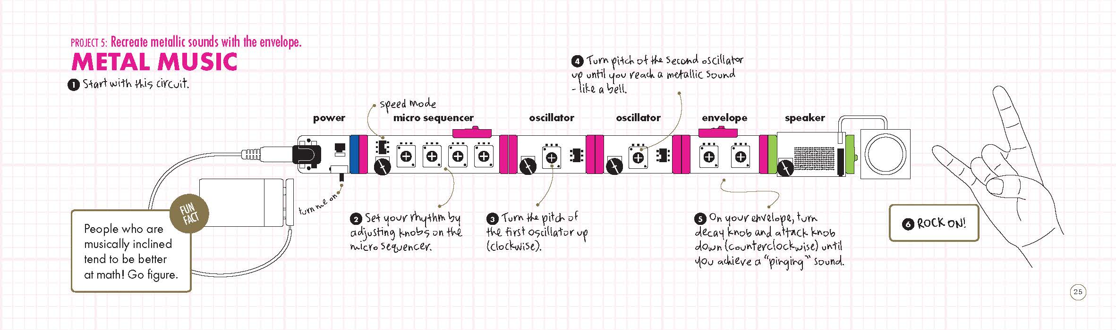
Creating your soundscape
Setting up—Connecting littleBits to Audacity
Layer 1: Rhythm
lib.uts.edu.au
UTS CRICOS PROVIDER CODE: 00099F

Slide 12
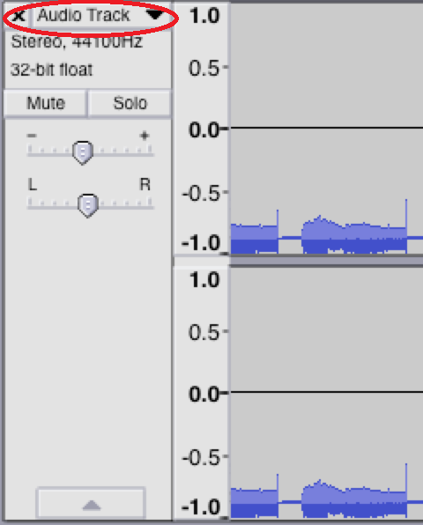
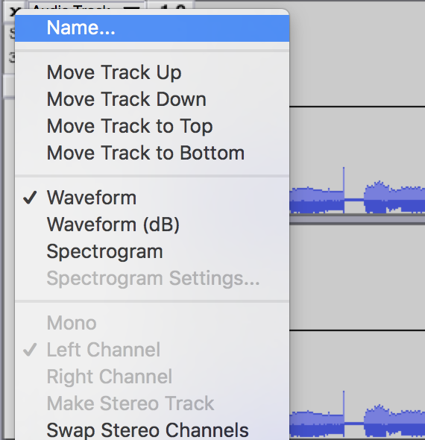
Creating your soundscape
Setting up—Connecting littleBits to Audacity
Rename each track
lib.uts.edu.au
UTS CRICOS PROVIDER CODE: 00099F

Slide 13
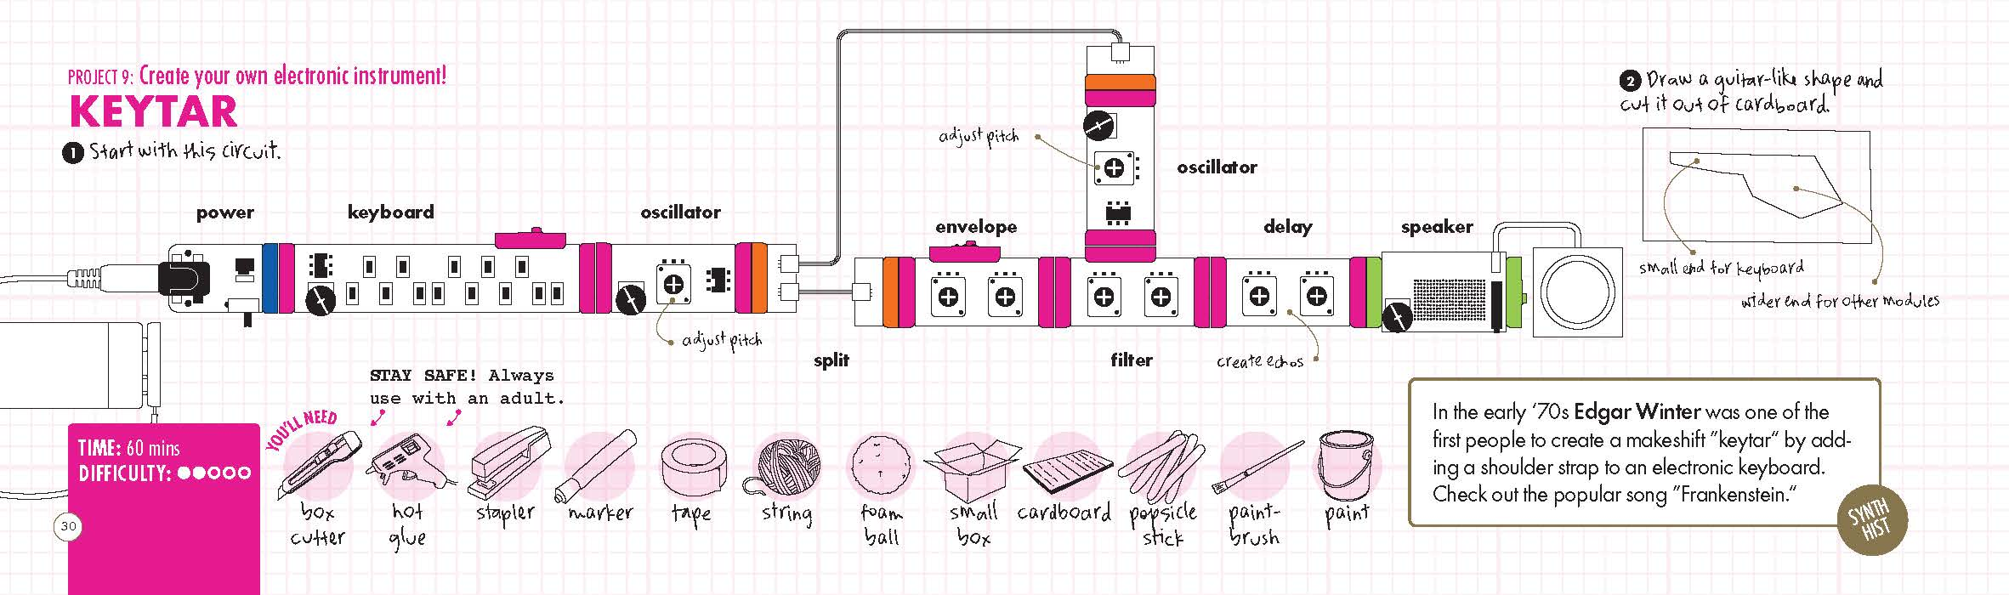
Creating your soundscape
Setting up—Connecting littleBits to Audacity
Layer 2: Melody
(don’t forget to rename each track)
lib.uts.edu.au
UTS CRICOS PROVIDER CODE: 00099F

Slide 14
Mixing
lib.uts.edu.au
UTS CRICOS PROVIDER CODE: 00099F

Slide 15
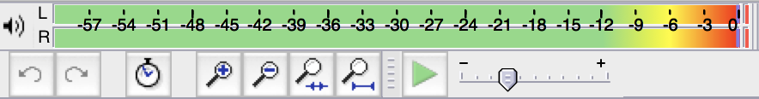
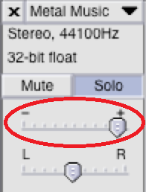
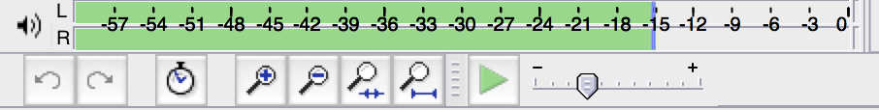
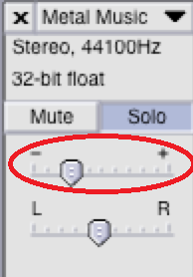
Mixing
Setting up—Connecting littleBits to Audacity
    Leveling
    Prevents the track from distorting signals
    Can be used to build up texture and create interest
lib.uts.edu.au
UTS CRICOS PROVIDER CODE: 00099F

Slide 16
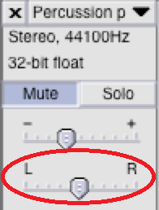
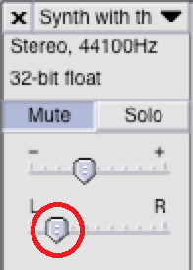
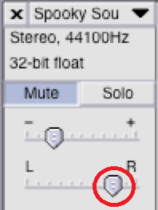
Mixing
Setting up—Connecting littleBits to Audacity
Panning
Panning is a great way to add movement to a tracks
For bass or rhythm tracks its best to keep them in the middle
Better to not pan all the way right or left
lib.uts.edu.au
UTS CRICOS PROVIDER CODE: 00099F

Slide 17
Exporting
lib.uts.edu.au
UTS CRICOS PROVIDER CODE: 00099F

Slide 18
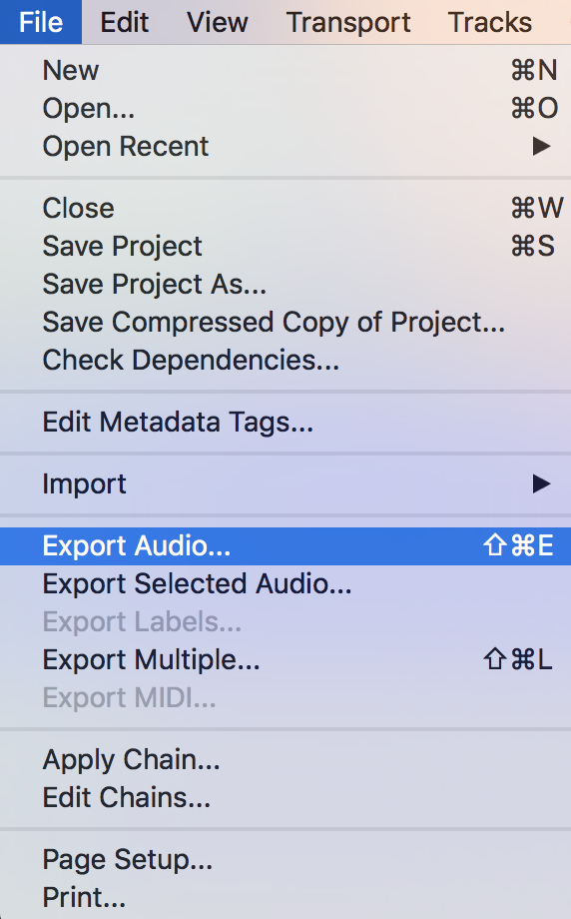
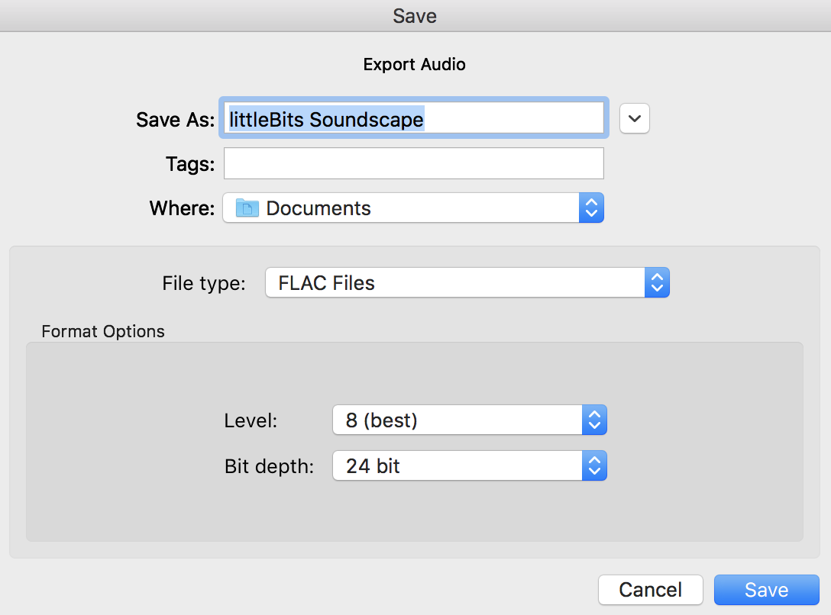
Mixing
Setting up—Connecting littleBits to Audacity
File > Export Audio
Name your project
lib.uts.edu.au
UTS CRICOS PROVIDER CODE: 00099F

Slide 19
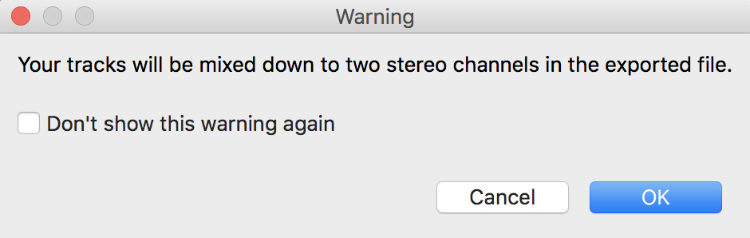
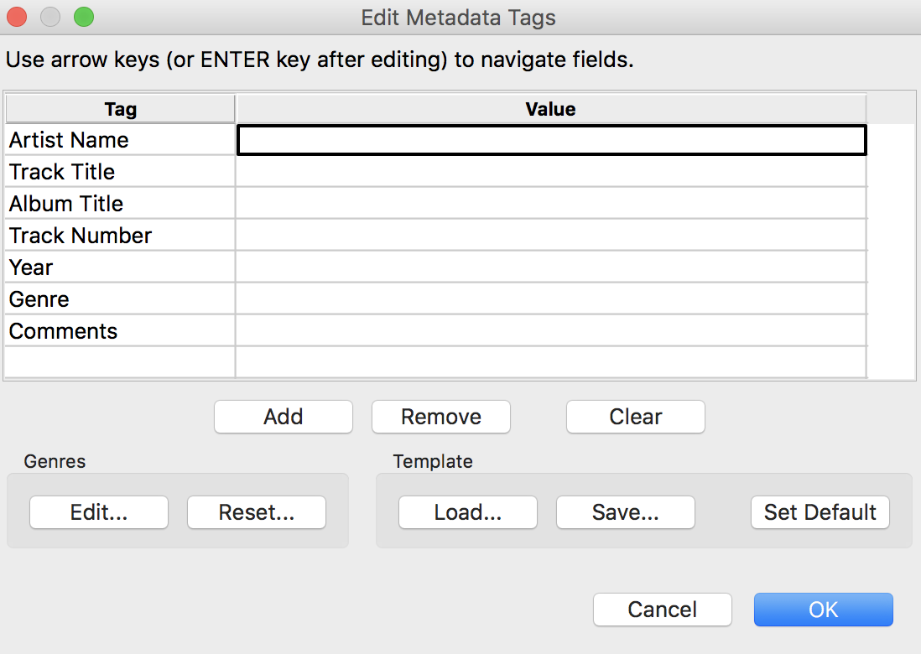
Mixing
Setting up—Connecting littleBits to Audacity
Warning – Click OK
Enter projects details
lib.uts.edu.au
UTS CRICOS PROVIDER CODE: 00099F

Slide 20
Reflection
lib.uts.edu.au
UTS CRICOS PROVIDER CODE: 00099F

Slide 21
Reflection
Setting up—Connecting littleBits to Audacity
How did you approach the activity?
What challenges did you encounter?
How did you overcome these challenges?
Did the technology aid or hinder your ability to perform the task?
lib.uts.edu.au
UTS CRICOS PROVIDER CODE: 00099F

Slide 22
Thank
you
lib.uts.edu.au
UTS CRICOS PROVIDER CODE: 00099F

